Slide 1
Sine Law
Grade 12 Essential Math
Geometry and Trigonometry Unit

Slide 2
Labelling Triangles
When labelling a triangle,
Label the angles with CAPITAL LETTERS
Label the sides with lower case letters
Opposing sides and angles have the same letters!
A
b
c
C
a
B

Slide 3
Internal Angles
In a triangle, the inside angles always add up to $180°$
$$47°+59°+74°=180°$$

Slide 4
Example
Determine the size of the missing angle:

Slide 5
Sine Law
We can use SOH CAH TOA to find sides and angles for right angle triangles.
But what if we don’t have a right angle?
Can we still solve the triangles?

Slide 6
Sine Law
Sine Law allows us to solve non-right angle triangles
$$\frac{\sin\left(A\right)}{a}=\frac{\sin\left(B\right)}{b}=\frac{\sin\left(C\right)}{c}$$
Angles
Sides
Choose the pairs that match what you have (or need)

Slide 7
Sine Law
To use sine law, we need pairs of sides and angles
We need a pair that we know and a pair where one piece is unknown

Slide 8
Example
Find the missing side

Slide 9
Example
Find the missing angle:

Slide 10
Example
Find the missing side:

Slide 11
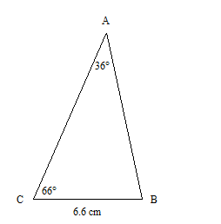
Example
Find the length of side AB

