Slide 1
Odds
Probability
Grade 12 Essential Math

Slide 2
Odds
The likelihood of an event occurring is not always expressed using probability.
It can also be expressed in terms of: “odds in favor” or “odds against” the event occurring.
The odds compares the desired events to undesired events
Odds are used frequently in the world:
Horse race tracks
Sports

Slide 3
Writing Odds
We write odds a bit differently from probability
Odds in favor
favorable outcomes : unfavorable outcomes
Odds against
unfavorable outcomes : favorable outcomes
What you want to happen
What you don’t want to happen

Slide 4
Example
I randomly select a student from the class.
What are the odds in favour of selecting a student who brought their phone today?
What are the odds against selecting a girl?
What are the odds in favour of selecting someone with long hair?

Slide 5
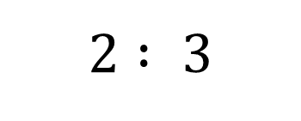
Note
When you write odds, the two sides add up to the total number of events.
This is useful for converting between odds and probability!
Odds
Probability
$$\frac{2}{5}$$
$$2 : 3$$
+

Slide 6
Example
Anthony rolls a 20-sided die.
What is the probability of rolling an even number?
What are the odds in favour of rolling an even number?
What are the odds against rolling an even number?

Slide 7
Example
Bob is drawing marbles from a bag: there are 5 green, 3 yellow and 1 red.
a) State the event.
b) State all the possible outcomes; how many possible outcomes.
c) State the probability of drawing a yellow.
d) State the odds for drawing green.
e) State the odds against drawing red.

