Slide 1
The costs of buying a home
Grade 12 Essential Math
Home Finance

Slide 2
Moving Costs
When you buy a home, the mortgage and down payment are not the only costs you have to pay.
There are many other one-time expenses that can surprise a first-time home buyer.

Slide 3
Down Payments
A down payment is a payment that you put on a house.
This lowers the amount of money that you need to pay with your mortgage.
You must have a minimum 5% of the cost of your house as a down payment
That means that (going by the average home price in MB) you must have $11,000 saved up!

Slide 4
Other costs
You will also need to pay for:
Property Appraisal: verify the value of the home
Mortgage Insurance: If you have less than 25% as a down payment
Survey: make sure the house is in the right place
Lawyer fees: register the title to your home
Property tax for the part of the year you own the home
Utility hookups

Slide 5
Other Costs
You might also have to pay for:
Repairs
Renovating
Landscaping
Appliances
Decorating
All these costs can add up to many thousands of dollars!

Slide 6
Example
Matt bought a house that has an annual tax bill of $1350. He moved in May 1. Calculate his portion of the property taxes.

Slide 7
GST and PST
When you have to pay for moving costs, you must pay GST on everything except for property tax and land transfer tax.
You only have to pay PST on optional costs

Slide 8
Example
Brittany is relocating to Brandon. She purchases a house for $120,000 and hires a mover to move her belongings. The mover charges $1,500 plus GST.
She hires a lawyer to look after the legalities for a fee of $800 plus GST.
An appraisal of the property is done at a cost of $120 plus GST. A survey of the property is done for a cost of $450 plus GST.

Slide 9
Example Continued
Her possession date is July 1st. The interest adjustment is $440. Annual property taxes are $1750
Before moving in, Brittany has sod installed in the yard for $1,500 plus PST and GST, and she gets a new stove and refrigerator for $750 and $900 respectively. Both appliances have PST and GST added to the cost.
She replaces the window coverings in the living room for $500 plus PST and GST and has the master bedroom and kitchen painted for $350 plus GST.

Slide 10
Example Continued
Brittany needs to increase her homeowner’s insurance. She decides to upgrade her existing policy for the rest of the year. The new annual premium is $680.
It costs $65 plus GST to hook up a telephone and to activate the natural gas costs $45 plus GST. Cable TV is $55 and electricity costs $35 to hook up.
Determine Brittany’s additional moving costs.

Slide 11
Example
Bill buys a buys a house from Chris. The possession date is May 1. The annual property taxes on the property are $4400.
Who pays the property tax adjustment?
Who receives the property tax adjustment?
Calculate the value of the property tax adjustment?

Slide 12
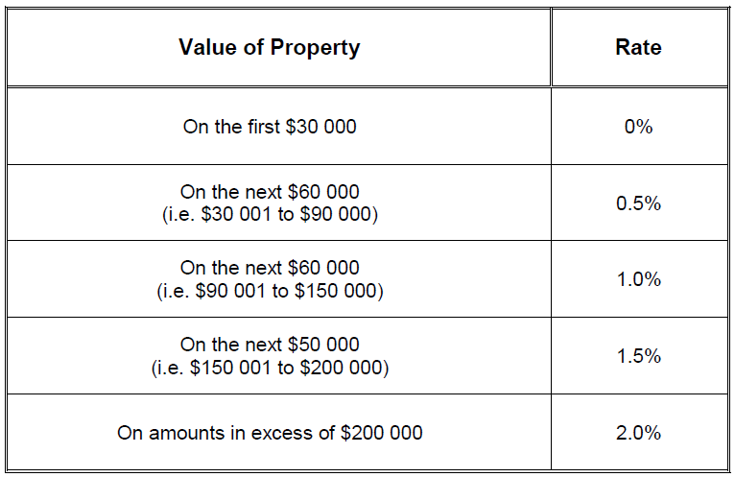
Example
Homeowners must pay a Land Transfer Tax when purchasing a property. This tax is calculated as follows:
Calculate the Land Transfer Tax due on a property valued at $80 000.

