Slide 1
Polygons
Grade 12 Essential Math
Geometry and Trigonometry Unit

Slide 2
Types of Polygons
A polygon is any shape with sides.
A regular polygon is a shape where all sides and angles are the same.
Not Regular
Regular!
Not Regular

Slide 3
Names
Name | # of sides
Triangle | 3
Quadrilateral | 4
Pentagon | 5
Hexagon | 6
Heptagon | 7
Octagon | 8
Nonagon | 9
Decagon | 10
Dodecagon | 12

Slide 4
Parts of a Polygon
Side
Internal/interior Angle
Diagonals
Central Angle

Slide 5
Internal/Interior Angles
The angles of a triangle add up to $180°$
The angles in a quadrilateral add up to $360°$
We can find the sum of angles in any polygon by using:
$$180°×(n−2)$$
n is the number of sides on the polygon.
We can use this to find the measure of one angle

Slide 6
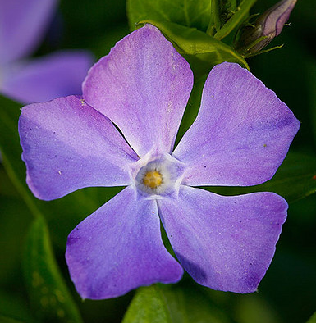
Example
What shape is made by connecting the tips of each petal of this flower?
What angle would be made at each tip?
$$θ$$

Slide 7
Central Angles
The sum of the central angles in a polygon always equals $360°$ (like a circle)
The measure of one central angle can be found by:
$$\frac{360}{n}$$
n is the number of sides on the polygon.

Slide 8
Examples
What is the measure of the central angle a regular quadrilateral?
A regular decagon?
If a regular polygon has a central angle of 45°, how many sides does it have?

Slide 9
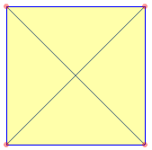
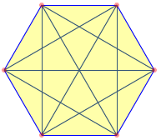
Diagonals
A diagonal runs from one corner in a polygon to another.
The number of diagonals in a polygon can be found by:
$$\frac{n\left(n−3\right)}{2}$$

Slide 10
Example
A nonagon is a 9-sided shape. How many diagonals would a nonagon have?

