Slide 1
Property Tax
Grade 12 Essential Math
Home Finance

Slide 2
Property Tax
Everyone who owns property needs to pay property tax.
Property tax goes to:
Municipal Governments (roads, local improvements, police, fire, ambulance)
Education (Provincial and school division)

Slide 3
Portion Percentage
The value of the buildings and land you own is called the assessed value.
You only have to pay property tax on a portion of the property you own. This is the portion percentage.
To find the portioned assessment:
$$Assessed value×portion percentage$$

Slide 4
Mill Rate
Property tax is given as a “mill rate”
Mill rate is “per 1000”
To find the tax:
$$\frac{Portioned Assessment}{1000}×mill rate$$
Per 1000
Means
Divide by 1000

Slide 5
Example
Kari has a house and land worth $250,000. The portion percentage is 45%, and the municipal tax is 38 mills.
Determine her portioned assessment
Determine her municipal tax

Slide 6
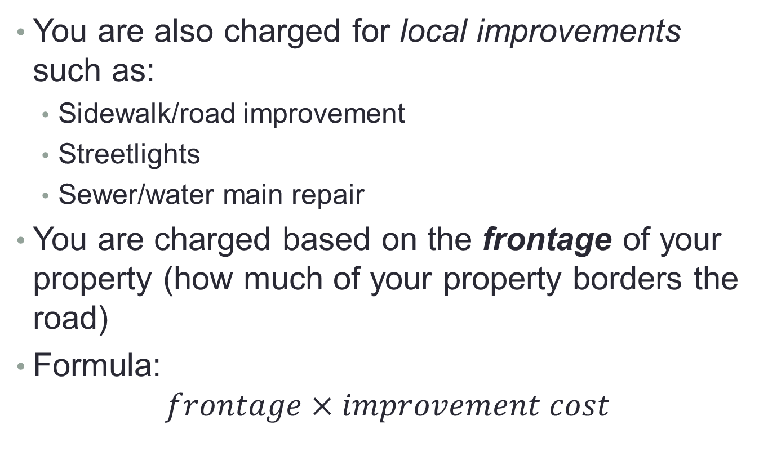
Local Improvement Costs
You are also charged for local improvements such as:
Sidewalk/road improvement
Streetlights
Sewer/water main repair
You are charged based on the frontage of your property (how much of your property borders the road)
Formula:
$$frontage×improvement cost$$

Slide 7
Example
Tori has a home with 50’ of frontage. The town charges him $1.25 per foot for sidewalk repairs and $1.00 per foot for lane oiling. Determine his local improvement tax.

Slide 8
Example
Adam owns a home in Ste. Anne with an assessed value of $150,000, and has a frontage of 75 feet.
The portioned percentage is 43%.
The municipal tax rate is 44 mills and the Education tax rate is 21 mills.
Local improvements:
Sewer Improvement: $1.50 per foot
Road resurfacing: $3 per foot
What is the total property tax bill?

Slide 9
Example
The Clement family owns a home with a house assessment of $210,000 and a land assessment of $70,000 with 50 feet of frontage,
Calculate the total portioned assessment
calculate the total tax payable if
municipal tax rate is 16.1 mills
the provincial school tax is 3.11 mills
the school tax is 15.740 mills
local improvement - Asphalt Surfacing is 13.41/foot
And a tax credit of $450

Slide 10
Advantages to Buying
When you buy a house, you own the house.
You will (eventually) pay off the house and not have to pay your mortgage!
You can renovate and change the house to your liking!
Your home will usually increase in value over time. It is an investment!

Slide 11
Advantages to Renting
Don’t have to pay property tax or homeowner’s insurance!
Sometimes don’t have to pay for all utilities.
Little to no maintenance.
Cheaper initial purchase costs (no lawyer, land transfer tax, CMHC fee)
Can move with little notice
Faster move in

